Slide 1
LC-MS for proteins/peptides identification and quantification
Zhijun Cao
Notes:
The topic I am going to talk about today is LC-MS for protein/peptide analysis.

Slide 2
Applications of high-resolution/high-mass accuracy LC-MS/MS for proteins/peptides
Protein identification
PTM characterization
Protein quantification
Label-free quantitation
Labeled approaches: Light and Heavy reagents can be used for relative quantitation (16O/18O, TMT, dimethyl labeling)
Spiking authentic stable isotope peptides into sample provides for molar quantitation. (The gold standard approach for quantitative mass spectrometry)
Notes:
LC-MS is a very useful tool in many fields.
One of the them, which have been playing critical roles, is proteomics.
Thanks to the advancement of mass spectrometry in the past two decades, the field of proteomics has been significantly changed.
Now with the high-resolution, high-mass accuracy, high-speed instrument, thousands and even over ten thousand of proteins can be identified and quantified in a single experiment as well as their post-translational modifications.
For protein quantification, there are different approaches:
1 label-free quantitation. It is easy to setup and also is cost effective. The limitation of the label-free approach is that if the project involved large number of samples, the reproducibility will be an issue.
In order to overcome this issue,
2 labeled approaches can be used. Samples from different conditions can be labeled with light and heavy reagents, and then pool the labeled samples, so two or multiple samples can be analyzed in as one sample. Which will reduce technique variation, and at same time increase the throughput. Of course, these approaches have some disadvantages: such as extra steps for sample preparation, the increase of sample complexity which may sacrifice some sensitivity, extra cost for the labeling reagents.
Label-free or labeled approaches mention above are relative quantitation.
3 Using MS, we can also absolutely quantify peptides by spiking authentic stable isotope peptides into sample, which can provide for molar quantitation. Actually, this is the gold standard approach for quantitative mass spectrometry.

Slide 3
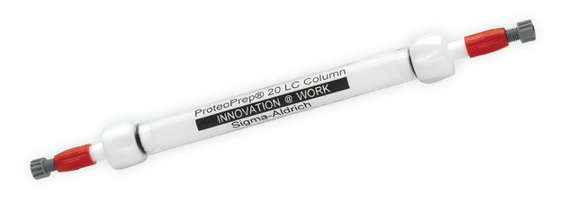

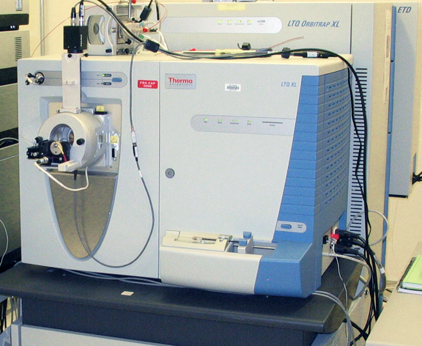
Workflows for quantitative protein analysis
Label-Free
Protein or Peptide Labeling
Metabolic Labeling
Blood/Tissue/Cell Culture
Blood/Tissue/Cell Culture
Animal/Cell Culture
¹⁴N/¹⁵N, SILAC
Protein extraction
Blood: High abundant proteins depletion
Proteins
Proteins
Proteins
Fractionation
Proteolysis
Peptides
Peptides
Peptides
TMT, dimethyl labeling
LC-MS-MS/MS
MRM
LC-MS-MS/MS
MRM
LC-MS-MS/MS
MRM
Data Analysis
Data Analysis
Data Analysis
Notes:
This slide shows label-free and labeled workflows for quantitative protein/peptide analysis.
There are different type of samples, such as blood, tissues, and cell cultures. These sample can be from human, animals, or in vitro / in vivo experiments.
Different colors represent different sample conditions we are interested in and want to compare between these different conditions, like disease against health, treatment against control.
In the label-free approach, samples are prepared, digested separately,
and the peptides from each sample are analyzed using LC-MS.
In order to increase the proteome coverage, we can add extra steps fractionation proteins or peptides to reduce sample complexity prior to MS.
In the labeled approach, the labeling can be performed at different stages of sample preparation.
The labeling can be performed at proteins level (e.g, ICAT) or at the peptide level (e.g., ¹⁶O/¹⁸O, TMT, and dimethyl labeling)
In metabolic labeling, proteins are labeled in the very early stage that is during protein synthesis.
culture cell with stable isotope-enriched media (e.g., ¹⁴N/¹⁵N media) or stable isotope-coded amino acids;
Feed animal with food containing stable isotope-coded amino acids
Obviously, this approach cannot apply to human.
Same as label-free approach, we can add extra fractionation steps to reduce sample complexity to improve proteome coverage, of course, this step should be done after pooled the labeled samples.
ICAT, isotope-coded affinity tag;
iTRAQ, isobaric tag for relative and absolute quantitation;
SILAC, isotope labeling by amino acids in cell culture;
TMT, tandem mass tag.

Slide 4
Case 1: strategies for in-depth analysis of plasma proteome
Challenges of plasma proteome analysis
Complexity (tens of thousands of proteins)
Wide dynamic range of protein concentrations (10 orders of magnitude in protein abundance)
Low abundant proteins
Strategies for reduction of plasma complexity
High abundant protein depletion
Sample fractionation at protein or peptide level
Notes:
Case 1 is about assessment of different strategies for in-depth analysis of plasma proteome.
Analyze plasma proteome is difficult because:
1. Plasma are highly complex samples, which contain tens of thousands of proteins.
2. Also concentrations of plasma proteins have wide dynamic range which can spread more than 10 orders of magnitude.
3. So these factors make difficult to detect low abundant proteins in plasma. Unfortunately, low abundant proteins are more interesting than abundant proteins in biomarker research.
In order to detect low abundant proteins, we need to reduce the sample complexity.
First, we often do, is to remove high abundant protein from plasma;
Second, the depleted samples can be fractionated at protein or peptide level.

Slide 5
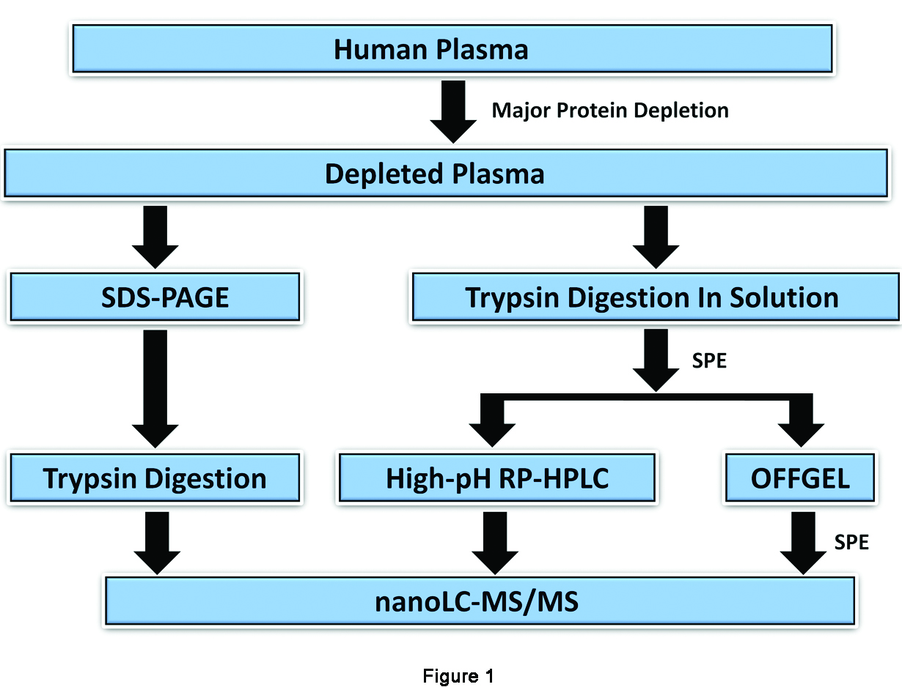
SDS-PAGE, OFFGEL, and hpRP-HPLC for plasma proteome workflows
protein
peptide
Notes:
This slide shows the workflow of side-by-side comparison of three fractionation methods for plasma proteome analysis.
First depleted high abundant proteins from plasma.
Then
fractionated sample at protein level and peptide level.
For protein fractionation, used SDS-PAGE gel
For peptide fractionation, digested proteins to peptides then fractionated peptides using OFFGEL or hpRP-HPLC.
All samples were analyzed with LC-MS.
Next I will move to details of the depletion and fractionation methods.

Slide 6
Plasma depletion
FPLC: AKTA (GE Healthcare)
ProteoPre20 Immunodepletion Column (Sigma-Aldrich)
Equilibration Buffer: 1x phosphate buffered saline
Elution buffer: 0.1M Glycine, pH2.5, 0.1% Octyl-β-D-glucopyranoise
Loading: 100 ul plasma
Depleted proteins (20): Albumin, IgG, IgA, IgM, IgD,Transferrin, a1-Acid Glycoprotein, Complement C1q , Fibrinogen, Ceruloplasmin, Complement C3, a2-Macroglobulin, Apolipoprotein A-I, Complement C4, a1-Antitrypsin, Apolipoprotein A-II, Plasminogen, Haptoglobin Apolipoprotein B, Prealbumin
Depleted plasma were precipitated with ethanol, and pellets stored at -20ºC
Notes:
This slide shows some details about the depletion.
The protein concentration in human plasma is about 60–80 mg/mL , of which about 50–60% are albumins and 40% globulins (10–20% immunoglobulin G, IgG)
Depletion column can remove greater than 99% of albumin and IgG
and greater than 95% of the remaining 18 highly
abundant protein, from a 100 uL plasma sample in a single pass.
Depleted plasma were precipitated with ethanol, and pellets stored at -20oC
The column may be reused at least 100 times with proper cleaning and storage.
The depletion column contains ~10 mL resin .
In our study, after depletion, concentration of plasma protein is about 3ug/ul

Slide 7
SDS-PAGE separation and In-Gel digestion
Reduced/alkylated depleted plasma on 12% NuPAGE mini-gel
1 cm (10 slices/lane 3x10ul): 10 fractions
2 cm (20slices/lane 3x10ul): 20 fractions
4 cm (40slices/lane 3x10ul): 40 fractions
De-stain and digest in 96 plates (40 ul 0.02ug/ul trypsin/well)
Notes:
For SDS-PAGE gel separation
Running samples on the gel for 1, 2 and 4 cm, then slice gel into 10, 20 and 40 fractions.
Gel slices were processed within 96-well plate.

Slide 8
In solution digestion
Re-suspend depleted plasma pellets in 8 M Urea/100mM ABC
Reduce (5.7 mM TCEP)/alkylate(25mM DMA)
Dilute to 4M Urea with 25 mM ABC
Digest with trypsin (enzyme/protein 1/100) for 4 h at 37 ºC
Dilute to 2M Urea with 25 mM ABC,digest with trypsin (enzyme/protein:1/50) at 37 ºC overnight
Clean sample with SPE
Resuspend in 0.1% FA, aliquot, stored in -20ºC
Notes:
Dissolved the depleted plasma pellets using 8 M Urea
Reduced with TCEP and alkylated with DMA
Diluted samples to 4 M Urea and digested with trypsin for 4 hours,
Then diluted samples to 2 M urea, added additional trypsin, digested overnight.
After digestion, cleaned samples with SPE.

Slide 9
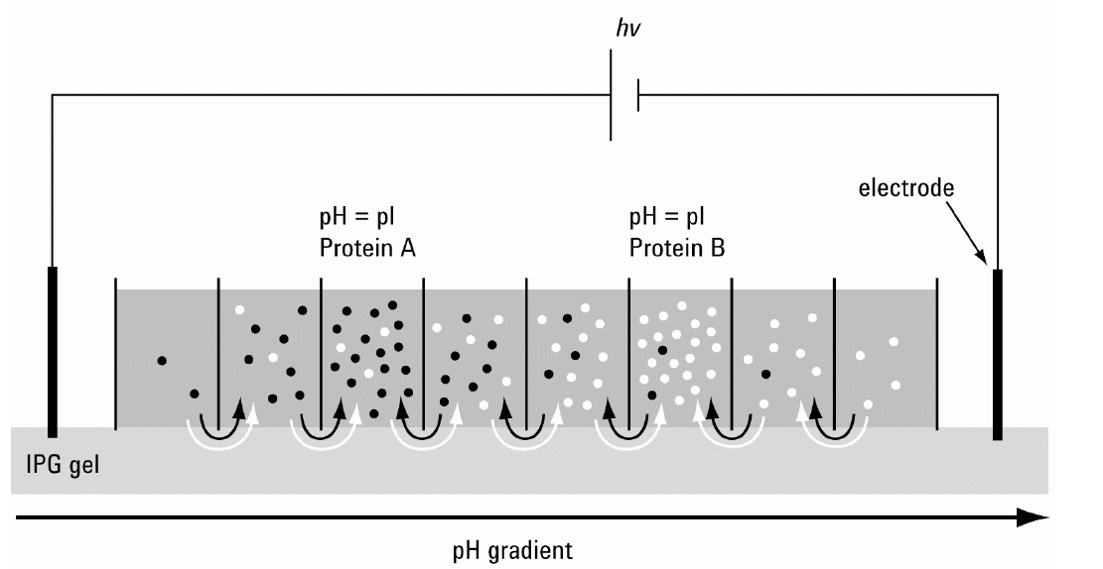
OFFGEL Fractionation
Agilent 3100 OFFGEL Fractionator
Low/High Resolution Kit (12/24 well, Agilent):
IPG strips: pH 3-10
Ampholytes (stock): pH3-10, 1.25x
IPG Strip Rehydration Solution: stock solution:dH₂O=4:1
Sample solution : 15 or 30 ul depleted plasma digest ( in 0.1% FA) +105 or 90ul dH₂O+ 480 ul stock solution (600ul)
PI
Peptide A
PI
Peptide B
Notes:
This slide shows some details of OFFGEL fractionation.
Differs from conventional gel electrophoresis in that the sample components remain in the gel. Instead, in OFFGEL, the sample are recovered from a buffer solution, making the recovery much easier.
pH resolution down to 0.1 unit depending on the consumable kit used.
pI obtained acts as an additional validation parameter.
Fractionation of up to 16 samples in parallel on 2 trays, accommodating 8 samples each.
Broad loading capacity up to 5 mg sample load.

Slide 10
High pH RP-HPLC separation
HPLC: Agilent 1100
Column: Xbride BEH300 C18 5um (2.1 x 250 mm)
Solvent A: 20 mM ammonia in water (pH10.7)
Solvent B: 20 mM ammonia in 80% ACN
Flow rate: 0.2 ml/min
Gradient:
Time/min | B%
0 | 3
8 | 3
70 | 50
71 | 88
86 | 88
86.5 | 3
96 | 3
Notes:
Xbride column can tolerate pH up to 12

Slide 11
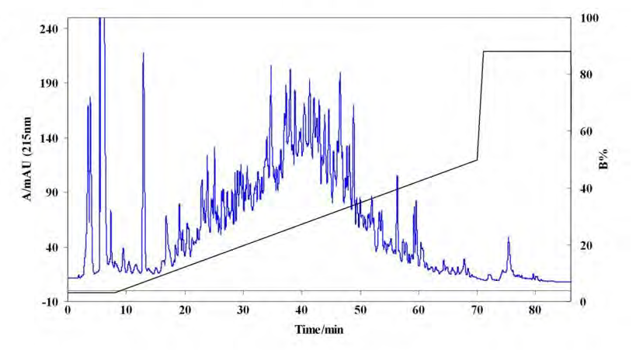
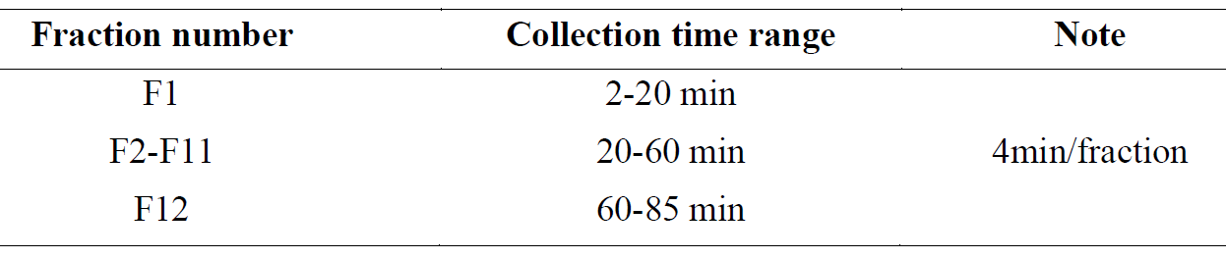
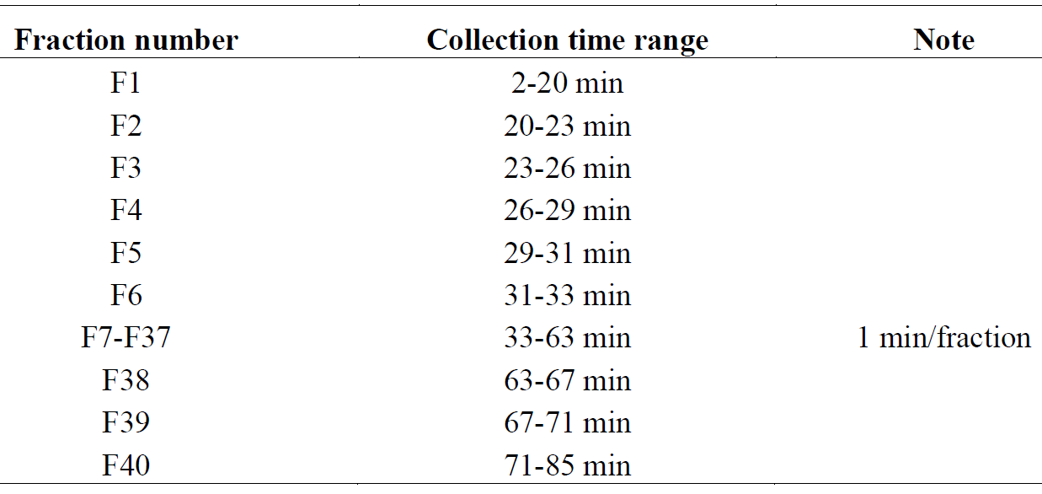
High pH separation
Notes:
This is chromatography of high pH HPLC of plasma digests.

Slide 12
nanoLC-MS-MS/MS
LTQ-Orbitrap XL
nanoAcquity UPLC
Trap column: 180 μm i.d. × 2 cm, 5 μm C18 resin(Waters)
Analytical column (self packed): 75 μm i.d. × 25 cm, 3 μm magic C18 resin (Michrom)
Full Scan: m/z 400 to 2,000, profile
Resolution: 60, 000 at m/z=400
DDA: 6 most intense ions
Tryptic peptides injection: approximately 0.5 µg
Notes:
This slides shows some details of LC-MS method parameters.

Slide 13
Data Analysis
Bioworks
Database: UniRef100, human
Indexed partial tryptic
Mass range 800 to 4500
Missed cleavage = 2
Static Cys = 99.0684 (alkylated)
Diff. Met = 15.9949
Diff. Asn=0.984016 (deamidation)
SEQUEST
Partial tryptic search
Peptide tolerance = 100 ppm
Fragment ions tolerance=1 AMU
DTASelect: Full tryptic filter,10ppm, DltCN 0.05
Nonredundant proteins and unique peptides
Notes:
Database search parameters

Slide 14
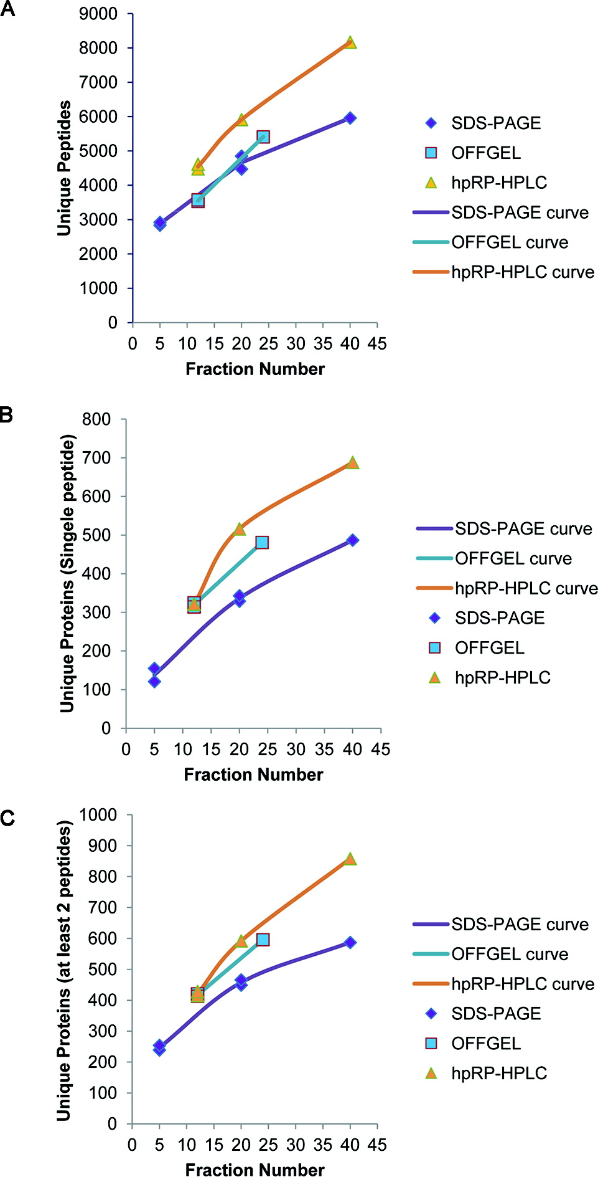
Numbers of Protein/peptide identified
Notes:
What we look here are proteins, peptides numbers identified by different fractionation methods.
Unique peptides. More fractions, more peptides identified. High pH fractionation gave greater number of peptide than OFFGEL and SDA-PAGE fractionation.
Proteins with one peptide
Proteins with at least 2 unique peptides
More fractions, more proteins identified. At 12 fraction, both High pH and OFFGEL are better than SDA-PAGE fractionation. With 24 or more fractions, high PH are better than OFFGEL and SDS-PAGE fractionations.

Slide 15
Overlap of protein identifications from the three separation methods.
Comparing to Gel 20 fractions
OFFGEL: 28% more
hpRP-HPLC: 27% more
Comparing to Gel 40 fractions
hpRP-HPLC: 46% more
Notes:
Here we look at overlap of proteins IDs among three fractionation methods.
There are big overlap among these fractionation methods.

Slide 16
Identification of known low-abundance proteins
Note : A low-abundant plasma protein list that includes 154 proteins with reported concentration of 100 ng/mL or less (Anderson L J Physiol 2005, Polanski, M.; Anderson, N. L Biomark Insights 2007)
Notes:
Another comparison we were interested in is look at numbers of the low-abundance proteins.
From this literature, we got a low-abundant plasma protein list which includes 154 proteins with reported concentration less than 100 ng/ml.
High pH fractionation gave the highest number of low abundant proteins.

Slide 17
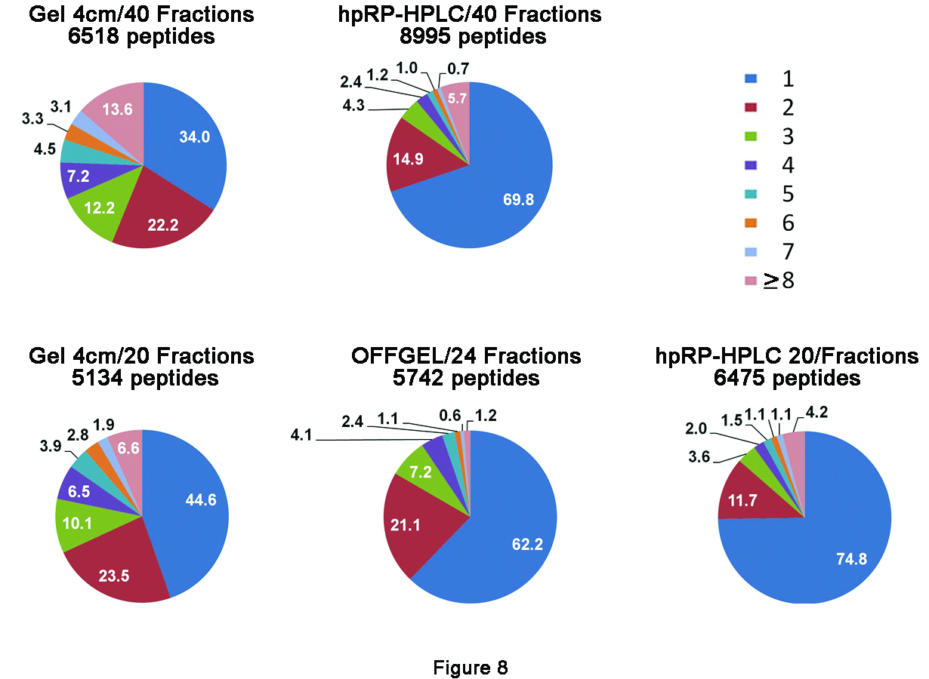
Separation efficiencies for the three fractionation methods
Notes:
After fractionation, a peptide may be enriched into one fraction or may be spread into multiple fraction.
Here we compared the separation efficiency based on the number of fractions that a peptide is spread into.
The number 1 means that peptide is enriched into 1 fraction, 2 means that peptide is spread into 2 fractions.
At 40 fractions level, for high pH, 70% of peptides were enriched into one fraction. For SDS-PAGE, it is only 34% .
At 20 fraction level, for high pH, 75% of peptides were enriched into one fraction. For OFFGEL, it is 62%, for SDS-PAGE, it is 45%.
So high pH separation efficiency is much better than OFFGEL and SDS-PAGE.

Slide 18
Case 1: summary
hpRP-HPLC is superior to OFFGEL or SDS-PAGE
Identified the largest number of proteins/peptides
Identified the largest number of low abundant plasma proteins
The highest separation efficiency
Unlike OFFGEL, the number of fractions is flexible
Low cost compared with OFFGEL
Notes:
We evaluated three fractionation methods for depleted plasma analysis and found that high pH gave the best performance based on the number of protein/peptides identified, low abundant protein numbers and separation efficiency.

Slide 19
Case 2: Development of MRM assay for kidney injury biomarkers using stable isotope labeled peptide standards
Goal:
Develop MRM assay for simultaneously quantification of eleven kidney injury biomarker candidates including IL6, IL18, KIM1, LCN2, Clusterin, Cystatin C, TFF3, Albumin, MGEA5, Osteopontin, and β2-microglobulin in rat urine
Notes:
Great efforts have been made to develop reliable biomarkers for early detection of acute kidney injury (AKI).
Some promising biomarkers have been identified for early detection, treatment monitoring or guiding drug development.
While most of these biomarkers require further verification.
Here, a multiple reaction monitoring (MRM) method was developed to simultaneously quantify eleven biomarkers including IL6, IL18, KIM1, LCN2, Clusterin, Cystatin C, TFF3, Albumin, MGEA5, Osteopontin, and β2-microglobulin using stable isotope labeled peptide standards.

Slide 20
MRM assay development and sample preparation
MRM development
Urine sample preparation
Target proteins
Rat Urine, 10 ml
Theoretically digest
Amicon Ultra-15 3K CUTOFF
Select tryptic peptides and inspect their uniqueness
Wash(2 ml 8M urea/50mM ABC ×3)
Verify peptides in related samples
Reducing and alkylation
Trypsin digestion
Refine peptides/transitions
SPE: MCX
MCX 1 cc Vac Cartridge, 10 mg
Optimize parameters (LC, MS)
Finalize MRM assay
Speed Vacuum Dry
Notes:
Workflows for MRM method development (left) and rat urine sample preparation (right).
Based on amino acid sequence of target protein, theoretically digest the protein and select tryptic peptides and inspect the peptide uniqueness. Verify peptides in related samples such kidney tissue sample, or recombinant proteins. Refine peptide/transitions based on retention time, peak intensity, stability.
Optimize parameters such as CE.

Slide 21
nanoLC-MRM and data analysis
Waters Xevo TQ-S
Waters NanoAquity
Buffer A : 0.1% formic acid in water
Buffer B: 0.1% formic acid in acetonitrile
flow rate: 400 nL/min
ACQUITY UPLC M-Class Peptide BEH C18(10mm, ID 150 um)
Column temperature: 45 °C
capillary voltage: of 2.8 kV,
source temperature: at 150 °C,
cone gas flow: 15 L/hr,
nebulizer gas: 0.1 Bar.
Skyline (MacCoss Lab) and R
Notes:
a triple quadrupole mass spectrometer (Waters Xevo TQ-S, Milford, MA)
coupled online with a nanoUPLC (Waters NanoAquity, Milford, MA).
Liquid Chromatography was performed using 0.1% formic acid in water as buffer A
and 0.1% formic acid in acetonitrile as buffer B,
at a flow rate of 400 nL/min.
Column temperature was controlled at 45 °C.
capillary voltage of 2.8 kV, source temperature at 150 °C, cone gas flow at 15 L/hr, and nebulizer gas at 0.1 Bar.
Heavy AQUA Quantpro peptide mixtures at different concentration levels (0.005 to 200 fmol/ul) were spiked in digested rat urine protein samples to generate calibration curves to determine the linear dynamic range, and lower limit of quantitation (LOQ) in rat urine samples.
Skyline (MacCoss Lab) was used to design MRM method and analyze the data.

Slide 22
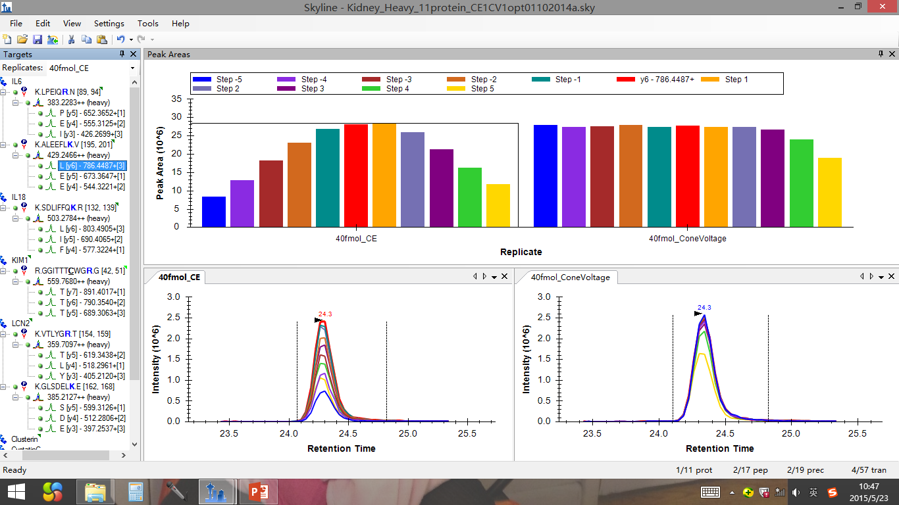
CE and cone voltage optimization
Notes:
Optimization of collision energy (CE) and cone voltage for all transitions using 40 fmol heavy peptides in 0.1 FA buffer. For CE optimization, it was set to use five step increase or decrease (step size=1) of the predicted value from the linear equation for Waters Xevo in skyline. For cone voltage, it was set to use five step increase or decrease (step size =5) of 35.

Slide 23
Schedule MRM to optimize dwell time and data points
Total transitions: 147
Data points/peak: 10 +
Dwell time/transition: 15 ms/transition+
Notes:
We also need to pay attention to dwell time and data points cross chromatographic peak. This should be optimized during method development.
The dwell time is the amount of time the instrument is collecting data for a specific transition (in milliseconds).
So increasing the dwell time will increase the sensitivity and precision of the method,
but it will reduce the number of SRM mass transitions that can be monitored in a given assay.
It is best practice to optimize the dwell time so that 12–20 data points are collected across a chromatographic peak.
The minimum number of points required to adequately define a peak is 10 data points.

Slide 24
Heavy AQUA Quantpro peptide mixtures were spiked in digests of rat urine samples (0.005 to 200 fmol/ul) to generate calibration curves to determine the linear range and lower limit of quantitation (LOQ)
Endogenous peptide abundance is below the LOQ
Notes:
Heavy AQUA Quantpro peptide mixtures at different concentration levels (0.005 to 200 fmol/ul) were spiked in digested rat urine protein samples to generate calibration curves to determine the linear dynamic range, and lower limit of quantitation (LOQ) in rat urine samples.
The left panel shows the measured peak area responses to variant concentrations (loading) of heavy peptides.
Loading is defined as injected amount (fmol) on column.
The right panel shows the plots of the measured ratio of nature peptide to heavy peptide (H/L) versus loading
Endogenous IL6 is very low,

Slide 25
Endogenous peptide concentration can be quantified.

Slide 26
Endogenous peptide concentration can be quantified.

Slide 27
Case 2: summary
Protein Name | Peptide Sequence | Charge | Linear Range (fmol)
IL6 | LPEIQR | 2 | 0.1 -200
 | ALEEFLK | 2 | 0.05-200
IL18 | SDLIFFQK | 2 | 0.5-200
KIM1 | GGITTTC[+57.0]WGR | 2 | 0.5-200
LCN2 | VTLYGR | 2 | 0.05-200
 | GLSDELK | 2 | 0.05-200
Clusterin | IDSLLESDR | 2 | 0.1-200
CystatinC | LLGAPQEADASEEGVQR | 2 | 0.5-200
 | ALDFAVSEYNK | 2 | 2-200
TFF3 | VDC[+57.0]NNR | 2,3 | 0.2-200
Albumin | DLGEQHFK | 2,3 | 0.02-200
 | APQVSTPTLVEAAR | 2 | 0.5-200
MGEA5 | GGLAGEFQR | 2 | 0.2-200
 | DVVILGR | 2 | 0.1-200
beta2-Microlglobulin | TPQIQVYSR | 2 | 0.2-200
 | TVTWDR | 2 | 0.1-200
Osteopontin | GDSLAYGLR | 2 | 0.2-200
An MRM method was developed to quantify eleven kidney injury biomarkers using Heavy AQUA Quantpro peptide as internal standard.

Slide 28
Case 3: dimethyl labeling for doxorubicin induce cardiac toxicity analysis
Introduction
Doxorubicin (DOX): an anthracycline chemotherapy drug for treatment a wide range of cancers
Major adverse effects: cardiotoxicity
Mechanism of cardiotoxicity: Oxidative stress, accumulation of toxic DOX metabolites, Iron metabolism, etc.
Elevated plasma cardiac troponin T (cTNT): biomarker of heart tissue damage
No known sensitive biomarkers for early injury prediction.
Goal:
Identify potential predictive biomarkers for DOX induced cardiotoxicity
Better understand the mechanism of DOX induced cardiotoxicity
Notes:
Doxorubicin, a chemotherapy drug, has been widely used to treat a wide range of cancer, such as leukemia, breast, ovary cancer etc.
Heart failure usually happened in one year after treatment, it can be also happened several years after the treatment.
How can doxorubicin cause cardiotoxicity? Some researches has shown that mechanism of cardiotoxicity may involves Oxidative stress, toxic DOX metabolites accumulation, Iron metabolism, disruption of energy , sarcomeric actin structure alterations
Currently, plasma cardiac troponin T (cTnT) has been used as clinical marker for myocardial injury. However, it is released in blood after tissue damage has occurred.
Unfortunately, there is no early biomarker available to predict cardiac injury.

Slide 29
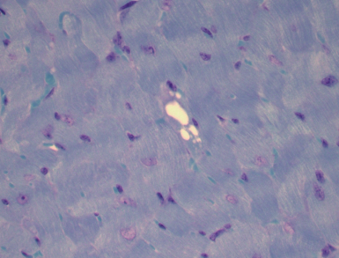
Experimental Design of the Study
Animals: B6C3F₁ mice (male)
Treatment: Doxorubicin or saline
Dose: 3 mg/kg body wt./week (i.v.)
Age (wks)
8
Troponins in blood
Exposure (wks)
0
2
3
4
6
8
Start
Cumulative DOX
dose (mg/kg)
6
9
12
18
24
Early Biomarkers of
Cardiac injury
Cardiac lesion
Sacrifice: a week after the last dose
Notes:
This slide shows the experimental design of the study.
Animal is B6C3F1, mice (male), treated with DOX or saline.
When starts treatment, mice age are 8 weeks.
DOX Treat dose is 3 mg/kg/week: treat time are 2, 3,4,6,8 weeks, cumulative dose are 6, 9, 12, 18, 24 mg/kg. Plasma cardiac troponin was monitored for each dose.
A week after the last dose, the mice were sacrificed.

Slide 30
Control Treatment
Animal treatment
Mouse tissue
Mouse tissue
Protein extraction
Enzymatic digestion
(trypsin)
Dimethyl labeling and mix 1:1
Peptide fractionation
(SCX)
Fluorescnce
% Salt Gradient
Time (min)
Light
Heavy
MS
MS/MS
LC-MS-MS/MS
Intensity
Intensity
m/z
m/z
Notes:
A quantitative proteomic approach using dimethyl labeling, multi-dimensional LC separation, and mass spectrometry (MS). Tissue samples from the control and treated mice are lysed separately. The extracted proteins are digested with trypsin. Equal amounts of peptides from the control and the treatment are subjected to dimethyl labeling with the light and heavy stable isotopes, respectively. The light and heavy isotope labeled peptides are mixed and then fractionated by HPLC such as strong cation exchange (SCX). Each fraction is analyzed by reversed-phase liquid chromatography coupled on-line with tandem mass spectrometry (LC-MS-MS/MS). While the MS/MS scans are used to identify the peptides, the MS scans are used to reconstruct the chromatographic peaks of the pair of labeled peptides. Relative quantitation is performed by comparing the peak areas of the peptides to identify potential biomarkers.

Slide 31
Number of proteins identified and quantified
2 week
6 mg/kg
3 week
9 mg/kg
4 week
12 mg/kg
6 week
18 mg/kg
8 week
24mg/kg
Notes:
There are five cumulative dose, we identified about seventeen hundred proteins, and quantified fifteen hundred proteins for each cumulative dose, so each cumulative dose has similar number proteins identified and quantified; after we combined five cumulative dose, total identified about three thousand proteins (2924), quantified about two thousand and two hundred proteins (2239).

Slide 32
Dimethyl-labeling of control sample
1.3x cutoff
FDR=3.6%
Notes:
First, we want to look at how efficiency the label method is. We take one control sample, split to equal two parts, labeled with light and heavy dimethyl, then pool, fractionation, then go to LC-MS/MS, analyzed the sample. Y-axis is protein number, x-axis is fold change range. Ideally, all ration should be equal to 1.
Total 1292, fold change for 85% proteins are less than 1.3, fold change for 96% proteins are less than 1.1. That means, if we use 1.3 as a cutoff, expected FDR for quantitation is 4%.

Slide 33
Distribution of quantified proteins
Sample | median CV(%) (total) | median CV(%) (1.3x)
A | 6.8 | 32
B | 5.7 | 28.3
C | 6.8 | 26.9
D | 6 | 19.9
E | 6.5 | 10
1.3x cutoff
↓ 1.3x
↑ 1.3x
Notes:
We look at variability of duplicates analysis for each cumulative dose, as shown in the table, median CV for total quantified proteins is less than 7%. We also look at those changed proteins, median CV is from 10% to 32%. So we think it is reasonable to use 1.3 fold change as a cutoff for further analysis.

Slide 34
Number of proteins with 1.3 fold change
cTnT
0.045ng/ml
cTnT
0.025 ng/ml
2 week
6 mg/kg
3 week
9 mg/kg
4 week
12 mg/kg
6 week
18 mg/kg
8 week
24mg/kg
Notes:
These are numbers of proteins with 1.3 fold change. Compared to first dose, protein number for second dose decreased, then protein number increase after that, and highest cumulative dose got the largest protein number with 1.3 fold change.

Slide 35
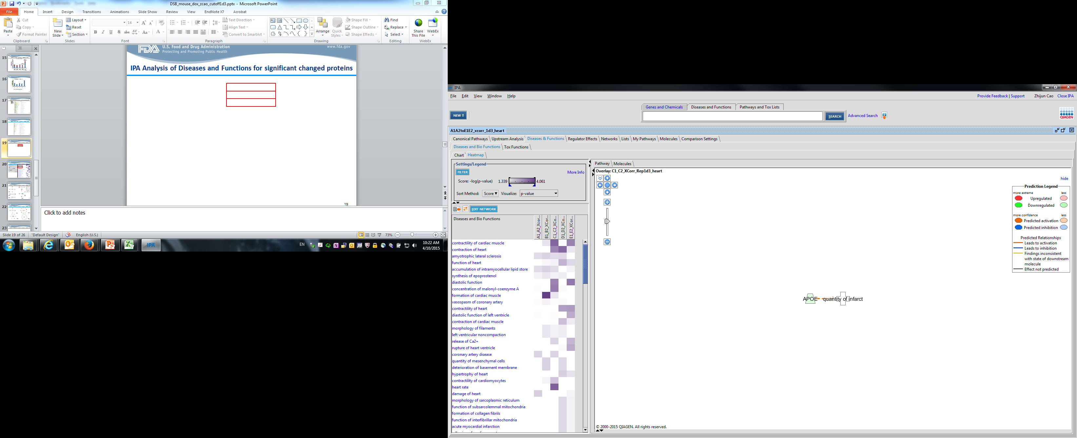
IPA analysis of diseases and bio functions
A B C D E

Slide 36
Proteins related to contraction of heart
Symbol | Accession | 2 week | 3 week | 4 week | 6 week | 8 week | Location | Type(s) | Biomarker Application(s)
MYH7 | Q91Z83 | 1.0 | 1.4 | 1.3 | 2.2 | 4.0 | Cytoplasm | enzyme | unspecified application
S100A1 | P56565 |  |  | 1.3 |  | 1.4 | Cytoplasm | other | diagnosis
PPP1CA | P62137 |  | 1.2 |  | 2.0 |  | Cytoplasm | phosphatase
LMNA | P48678 | 1.1 | 1.1 | 1.0 | 1.0 | 1.4 | Nucleus | other
Pln | P61014 | 1.3 | 1.2 | 1.1 | 1.1 | 1.8 | Cytoplasm | other
CALR | P14211 | 1.5 | -1.1 | 1.1 | 1.2 | 1.4 | Cytoplasm | transcription | unspecified application
HSPB7 | P35385 | -1.0 | 1.1 | 1.0 | 1.0 | 1.6 | Cytoplasm | other
MYL4 | A2A6Q8 | 1.1 | -1.1 | -1.1 | -1.6 | 1.1 | Cytoplasm | other
MYL7 | Q9QVP4 | 1.1 | -1.1 | -1.0 | -1.5 | 1.2 | Cytoplasm | enzyme
NPPA | P05125 | 1.2 | -1.1 | -1.1 | -1.3 | 1.3 | Extracellular Space | other | diagnosis,efficacy,prognosis,unspecified
GPX1 | P11352 | 1.0 | -1.2 | -1.4 | -1.1 | -1.1 | Cytoplasm | enzyme | diagnosis,efficacy
ATP1A2 | D3YYN7 | -1.1 | -1.4 | 1.4 | 1.1 | -1.1 | Plasma Membrane | transporter
CAPNS1 | D3YW48 | 1.0 | -1.0 | -1.4 | 1.0 | -1.3 | Cytoplasm | peptidase
SOD1 | P08228 | 1.5 | -1.5 | -1.3 | 1.9 | -1.2 | Cytoplasm | enzyme | unspecified application
CSRP3 | P50462 | -1.3 | -1.2 | -1.4 | 1.0 | -1.5 | Nucleus | other
CAMK2D | Q8CCM0 |  |  | 1.0 | -1.6 | -1.1 | Cytoplasm | kinase
ASPH | A2AL78 | 1.2 | -1.1 | 1.0 | -1.1 | -1.5 | Cytoplasm | enzyme
Tpm1 | B7ZNL3 | -1.4 | -1.3 | -1.3 | -1.1 | -1.1 | Plasma Membrane | other
PRKACA | P05132-2 |  |  |  | -1.0 | -1.4 | Cytoplasm | kinase
DMD | P11531 | -1.1 | -1.1 | -1.2 | -1.5 | -1.4 | Plasma Membrane | other
RYR2 | E9Q401 | -1.1 | -1.1 | -1.2 | -1.3 | -1.6 | Plasma Membrane | ion channel
SRI | Q6P069-2 |  |  | -1.5 |  |  | Cytoplasm | transporter
Notes:
22 proteins
Symbol GN Accession
MYH7 myosin, heavy chain 7, cardiac muscle, beta Q91Z83
S100A1 S100 calcium binding protein A1 P56565
PPP1CA protein phosphatase 1, catalytic subunit, alpha isozyme P62137
LMNA lamin A/C P48678
Pln phospholamban P61014
CAMK2D calcium/calmodulin-dependent protein kinase II delta Q8CCM0
PRKACA protein kinase, cAMP-dependent, catalytic, alpha P05132-2
SRI sorcin Q6P069-2
CALR calreticulin P14211
ASPH aspartate beta-hydroxylase A2AL78
CAPNS1 calpain, small subunit 1 D3YW48
SOD1 superoxide dismutase 1, soluble P08228
MYL4 myosin, light chain 4, alkali; atrial, embryonic A2A6Q8
MYL7 myosin, light chain 7, regulatory Q9QVP4
NPPA natriuretic peptide A P05125
GPX1 glutathione peroxidase 1 P11352
HSPB7 heat shock 27kDa protein family, member 7 (cardiovascular) P35385
ATP1A2 ATPase, Na+/K+ transporting, alpha 2 polypeptide D3YYN7
CSRP3 cysteine and glycine-rich protein 3 (cardiac LIM protein) P50462
Tpm1 tropomyosin 1, alpha B7ZNL3
DMD dystrophin P11531
RYR2 ryanodine receptor 2 (cardiac) E9Q401

Slide 37
Case 3: summary
Dox treatment induced proteins change in heart tissue (168, 132, 174, 156 , and 363 differentially expressed proteins were identified at dose 6, 9,12, 18, 24 mg/kg body wt.)
IPA analysis: changed proteins related to contractility of cardiac muscle, contraction of heart

Slide 38
Thanks!

